Slide 1


Exploring identity online
Assembly for ages 11-14

Slide 2
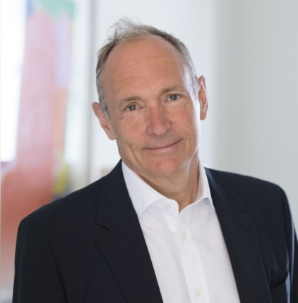
Sir Tim Berners-Lee, inventor of the World Wide Web.
The web is now over 30 years old.
The web is for everyone.
Or is it?
Notes:
Sir Tim Berners Lee image by Henry Thomas
https://metro.co.uk/2019/03/12/tim-berners-lees-net-worth-world-wide-web-celebrates-30th-anniversary-8887298/

Slide 3





Almost 8 billion
58% have internet access
Over 5 billion have a mobile device
Almost 2 billion websites

Slide 4

Online identity
How do people express their identity online?
Is the internet a safe and welcoming place for all?
Do people feel free to be themselves online?

Slide 5
I don’t understand fake people online. Be real or don’t bother.
AGREE
DISAGREE

Slide 6
Most people want to be themselves online.
AGREE
DISAGREE

Slide 7
Being yourself online makes you more vulnerable to the haters and bullies.
AGREE
DISAGREE

Slide 8

Sharing the highlights
Is the internet the only way that people present this best version of themselves?

Slide 9







Is there a variety of people or are they very similar?

Slide 10

Do you see people like you online?
Does it matter?

Slide 11

The internet is not for all…yet
This is why some people act a little differently online.
This is why some people only share certain things with their closest friends online.
This is why some people say that being ‘real’ makes you vulnerable.
This is why some people do not feel part of it.

Slide 12

What needs to change?
All of us need to make the online world a more welcoming place?
Individuals need to be more real and express themselves?

Slide 13
Sir Tim Berners-Lee, inventor of the World Wide Web.
The web is for everyone and collectively we hold the power to change it.
Notes:
Sir Tim Berners Lee image by Henry Thomas
https://metro.co.uk/2019/03/12/tim-berners-lees-net-worth-world-wide-web-celebrates-30th-anniversary-8887298/

Slide 14
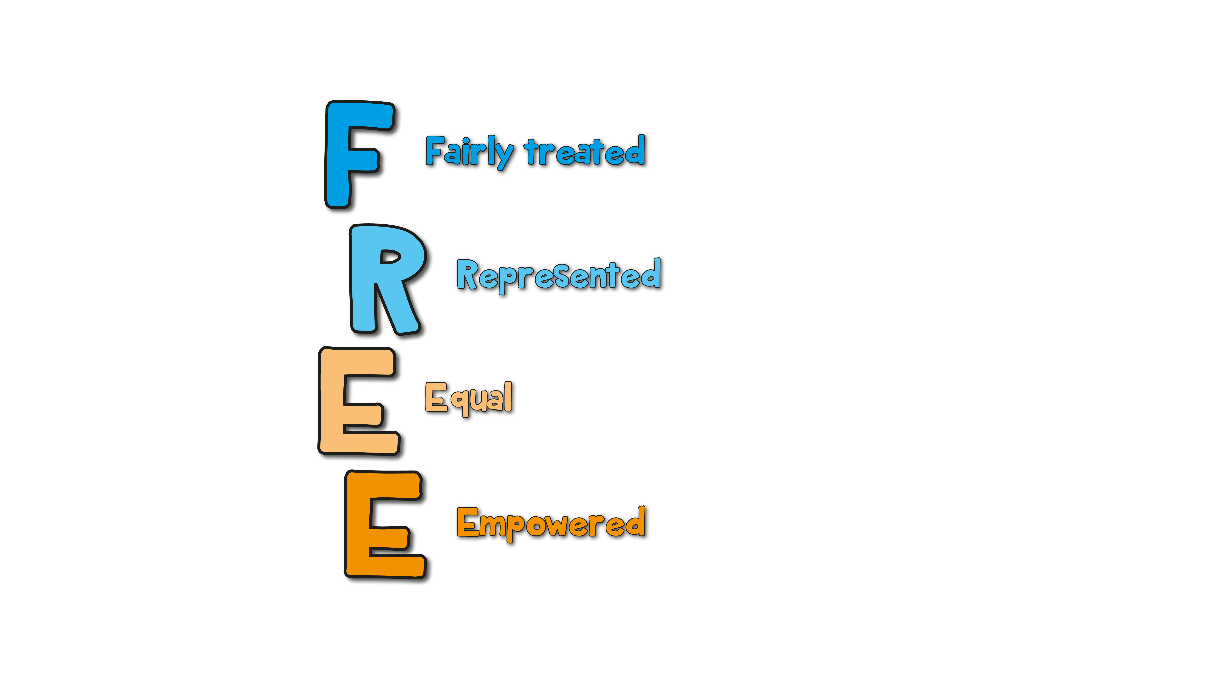
People should feel welcome and free online.

Slide 15




What can we all do?
Become allies.
Report negative comments.
Reach out.
Broaden our feeds.

Slide 16


